Slide 1

Data Warehousing
Presented By: Aasthaba Zala, Darsh Parikh, Jenish Patel
Instructors: Dr. Kalyani Selvarajah
Course: COMP-8157 Advanced Database Topics
Date: July 25,2021

Slide 2
Introduction
Data warehouses increase the speed and efficiency of accessing different data sets and make it easier for business decision-makers to obtain information that will guide business and marketing strategies and differentiate them from competitors.
This project focuses on creating a variety of data warehousing and OLAP approaches, with a particular emphasis on their new standards.
The project can utilize Data Warehouse functions like data cleaning, data mining, and data transformation.
Data Warehouse also includes OLAP tools for querying and analyzing data from many perspectives.

Slide 3
Why our project is important?
We have implemented some advanced operations. In addition, we have defined the proposed star schema for the data warehouse and estimate its size and growth over time.
WE have determined the data system's primary goal and offered several analytical queries for the system.
We have defined ETL workflow in this project.
Moreover, we implemented Data Warehouse and used different OLAP operations.
We have identified long queries and long dimensions.

Slide 4
Existing Works
Sr. no | The name of the work | Link | Significant work | Limitation of their model/ product
1. | Chaudhuri, S., & Dayal, U. (1997). An overview of data warehousing and OLAP technology. ACM Sigmod Record, 26(1), 65-74 | https://www.microsoft.com/en-us/research/wp-content/uploads/2016/02/sigrecord.pdf | It explains methodologies of database. It describes the architecture of Data warehouse. | They have issues regarding data cleaning for heterogeneous network.
2. | Arun Sen and Atish P. Sinha, “A Comparison of Data Warehousing Methodologies”. ACM March 2005/Vol. 48, No. 3 | https://dl.acm.org/doi/fullHtml/10.1145/1047671.1047673 | It shows the comparisons of Data Warehouse methods. | Most of the companies do not use this methodologies concepts.

Slide 5
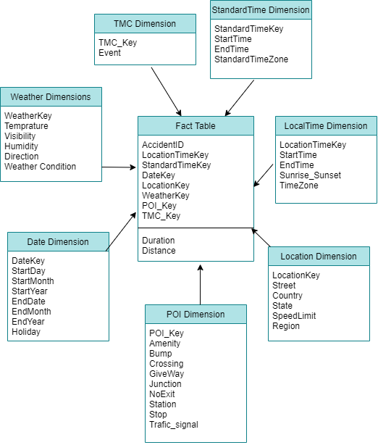
Star schema of proposed Data Warehouse

Slide 6
Demo

Slide 7
Conclusion
This project covers various advanced database topics. We have used US’s accident data set of four years. We have used different attributes such as date, time, GPS, location, city, temperature, coordinates etc. We have made fact table using different attributes.
People can find out about the frequency of the accidents using our project. In addition, it shows the timings when there is more chances of accidents. The factors of the accidents. The rate of accident per year.
So, we have learnt various topics of the data warehouse and OLAP. We deeply understood the ETL workflow.

Slide 8
Future Direction
We have used datasets of specific country for a specific period of time. Here, we implemented various concepts using numerous attributes.
In the future, we are planning to use this concept for different countries. Moreover, we want to implement the Data Warehouse for more bigger datasets.
We also want to add few attributes in our project that will give more information about the topic.

Slide 9
References
1. Redelmeier et al. (2017), The full moon and motorcycle related mortality: population based double control study, https://doi.org/10.1136/bmj.j5367;
2. Elflein, J. (2019), Per capita alcohol consumption of all beverages in the U.S. by state - 2017, https://www.statista.com/statistics/442848/per-capita-alcohol-consumption-of-all-beverages-in-the-us-by -state/;
3. U.S. Office of Highway Policy Information (2018), State Motor-Vehicle Registrations - 2018, https://www.fhwa.dot.gov/policyinformation/statistics/2018/mv1.cfm
4. Moosavi, S. (2020), A Countrywide Traffic Accident Dataset (2016 - 2019), Kaggle, https://www.kaggle.com/sobhanmoosavi/us-accidents;
5. OpenStreetMap (2020), TMC - Event Code List, https://wiki.openstreetmap.org/wiki/TMC/Event_Code_List

Slide 10
Thank You

